Slide 1
Sockets and Systems
Combination

Slide 2
TODO Next Semester
Show basic socket networking
Socket example: Convert stdin, stdout, and stderr to socket
Accept multiple connections for socket in multiple processes

Slide 3
TODO:
Waving hands: Hardware (NIC)
IP (IP Addresses)
TCP / UDP (Ports)
Sockets
DNS
NAT (Private address, public address) + NAT Punching
non blocking IO
Next:
Architectures: P2P, Client Server
Protocols in general
Case studies: SSH, LSP
Notes:
Ideas:
hands on before doing in depth?
More flexible pipes, so why so much more complicated??

Slide 4
Review
IPC
File Descriptors
Files
Pipes
Signals
Sample Program putting it all together

Slide 5
Signals
Asynchronous “Signals” you can send to processes
There are a preset number of possible signals, all with default actions
Typically used for configuration and management of programs
Example
Syscalls: sigaction(2), raise(2) and kill(2)

Slide 6
Code Study: Mail Server with Database
Goal: Create a mail server process which handles user input, and a database server process, which handles saving and retrieving data from files efficiently
Notice how the mail server and database have a Specification for how to communicate
Source

Slide 7
3 Types of Programs
Services / Daemons: Run in background
Tools: Run once
Libraries: Used

Slide 8
Common Pattern
Typically you won’t directly interact with programs through their interface
Instead we have another program that knows the Specification, and will interact with it on your behalf.
Systemd? Systemctl?

Slide 9
Issue
Limited by other IPC’s:
Can only send data to children
Can only send data to processes on the same computer
No bidirectional communication

Slide 10
The Internet and Sockets

Slide 11
Disclaimer
There is a lot of complexity to how the internet works.
If you are interested in learning more, read TCP/IP Illustrated or take System Design (OS is a prerequisite)
Just know a lot of the “How” is implemented by hardware devices (NIC, Routers, ISP infrastructure, etc) and protocols

Slide 12
What is the Internet?
3 Guiding principles
Best-Effort Packet Delivery Service
End-to-End argument
A network of networks

Slide 13
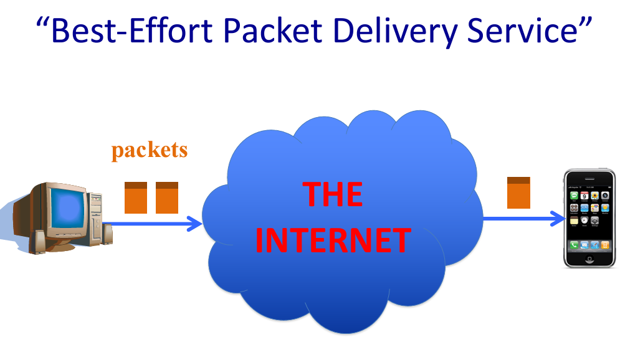
Notes:
Packets are bundles of data. You can think of it as an array that you send to another device.
The Internet is a packet switching system. Any message is broken into packets that are transmitted independently across the interment (sometime by different routes). These packets are then recieved and reassembled at the destination.

Slide 14
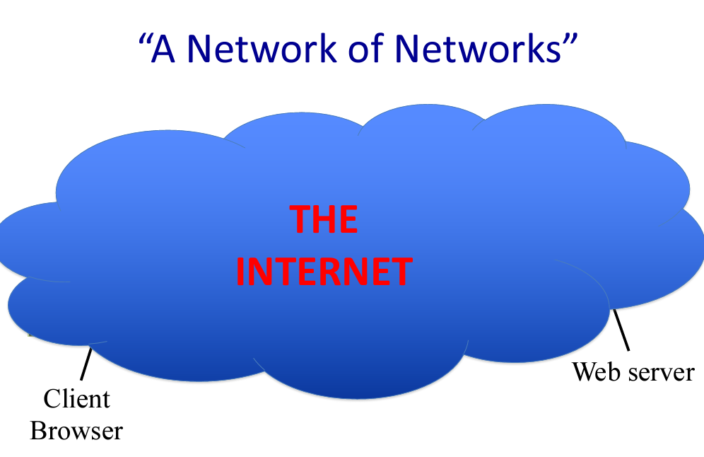
Notes:
Recursive, this allows it to scale

Slide 15
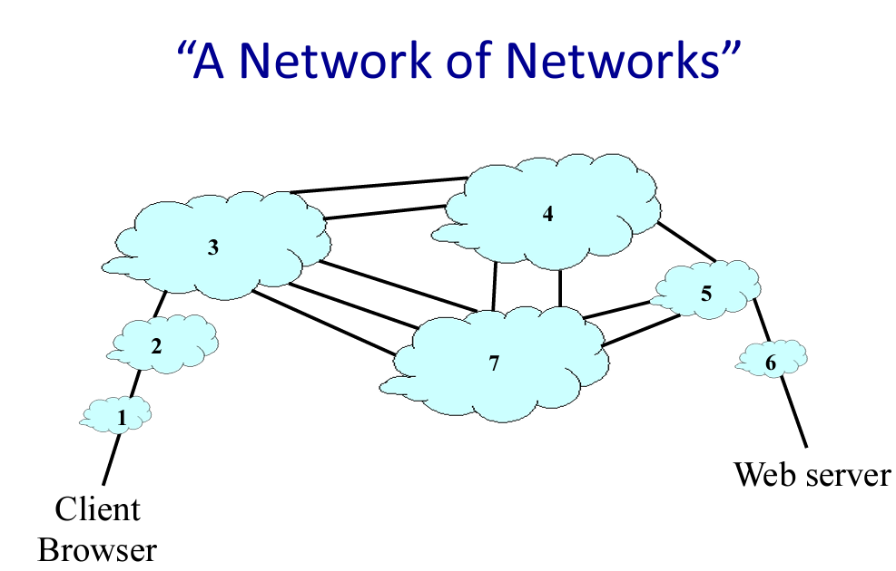
Notes:
each of these clouds are made of sub clouds, until we get down to individual hardware devices - Like routers and computers

Slide 16
At its most basic level
IP Protocol - The backbone of the internet
Unidirectional Unreliable Byte stream communication
Computer to computer communication (one stream per computer)
Assumption: There is the necessary infrastructure present to make this possible
Specification
Notes:
Documentation: Know where to find it. For computer networking, protocols are the only way for things to work. The RFC’s are the standards
Notice the header and payload section
Reminder of a protocol: Behavior and what the data being transmitted looks like

Slide 17
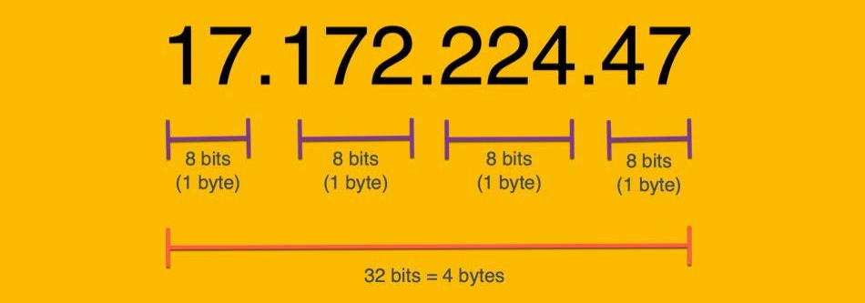
IP Addresses
Address of a computer interface - Provided by ISP
A computer may have multiple network interfaces
Each value in range [0,255]
Example: ping 8.8.8.8
Notes:
Everything on the internet has an IP address

Slide 18
IP Addresses 2
There are a many reserved IP addresses - Here are a few:
0.0.0.0: Wildcard: Bind to all interfaces (all IP’s your computer has)
127.0.0.1 - 127.255.255.255: Loopback address - Your computer
172.0.0.1, 10.0.0.1, 192.168.0.1: Private IP Addresses
https://www.iana.org/
Example: ifconfig
Notes:
If you are self hosting a server, you will test it by typing in 127.0.0.1
We will learn about private IP address when we get to NAT: Network address translation
iana
ifconfig will show all the Interfaces (IP addresses) our computer has

Slide 19
Basic Interface
send(msg, ip_address)
msg = receive(ip_address)
Notes:
# specifying ip address is important since a computer might have many as we previously saw

Slide 20
Example
send(“Hello world”, 127.0.0.1) # send msg to your computer
send(“Whats up”, 8.8.8.8) # send msg to google's DNS servers
msg = receive(127.0.0.1)
msg = receive(0.0.0.0) # get msg from any of the ip addresses your computer has
msg = receive(23.239.16.203) # get message from this ip (assumes this is one of your IP’s)
Notes:
Trying to code this up in C is pretty awful.

Slide 21
System Calls
Client:
socket(2) => connect(2) => read(2)|write(2)|send(2)|recv(2)
Server:
socket(2) => bind(2) => listen(2) => accept(2) => read(2)|write(2)...
See: socket(7), ip(7) and socket(2) for overview
Code

Slide 22
IP: Not enough
We would like:
Ability to send to individual processes instead of just a computer
Reliability
Bidirectionality
Solution: There are many protocols built on IP to provide additional guarantees

Slide 23
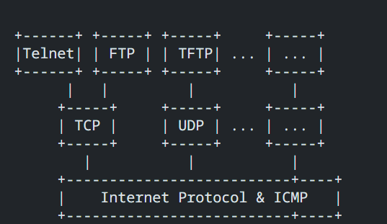
Hierarchy
Notes:
This is just a tiny look at all the protocols
In general should know IP, TCP, UDP, and not listed is HTTP

Slide 24
TCP and UDP
Protocols build directly on top of IP
Allow for sending of byte strings with additional guarantees
TCP UDP
Port Multiplexing Port Multiplexing
Reliable Unreliable
Bidirectional Unidirectional
Notes:
draw out how a TCP and UDP use IP
Sending message with TCP Requires the endpoint also is using TCP.

Slide 25
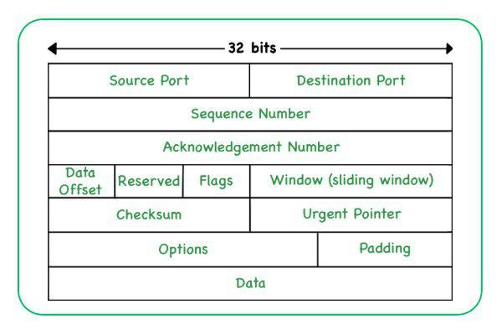
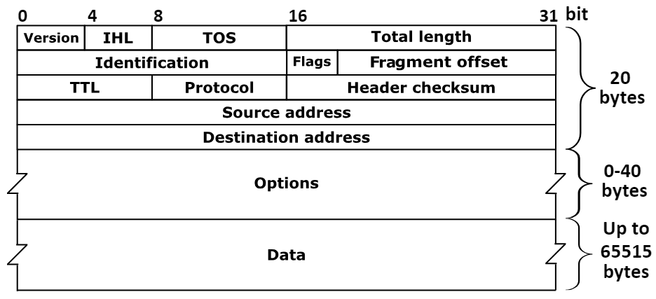
How: Layering of Protocols
TCP/UDP Message is created, then placed in the Data section of IP message
If too big, split up into many IP packets
Software at other endpoint must also be using the same protocol
Wireshark
Notes:
Show wireshark

Slide 26
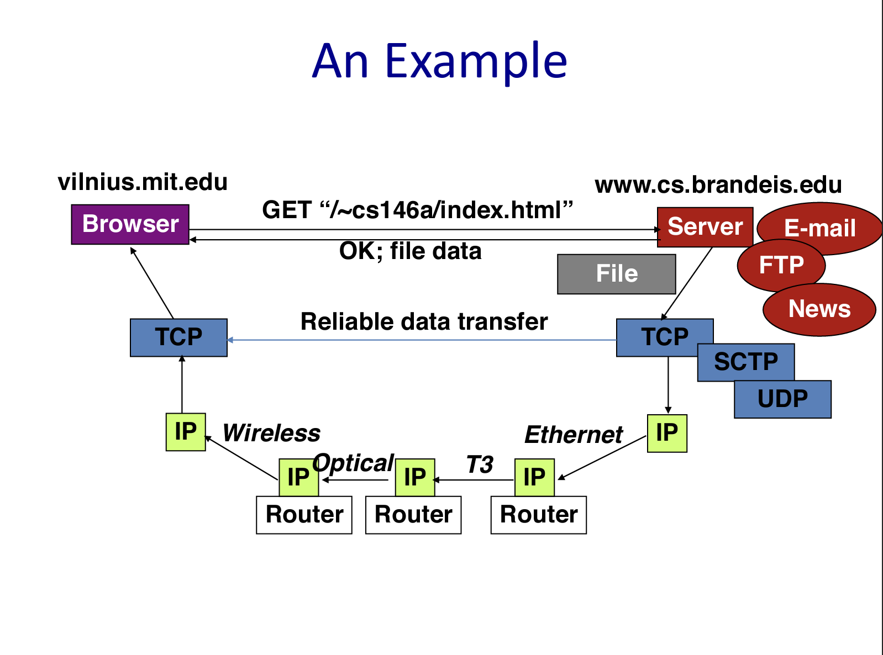

Slide 27
Hands on: Sockets
Example
Socket networking is pretty awful… Create abstractions to make creating a client and server easier
TODO: Provide mostly made socket server with something missing and provide manpages to complete
Notes:
Socket(7) is the best starting point for Socket Networking, then check out ip(7)
If you can navigate the socket manpages, you can do anything.

Slide 28
Basic && Essential Networking Commands
Netcat (nc)
ping
ifconfig | ipconfig --all
curl | wget
tcpdump

Slide 29
Base Layers
Notes:
As you may have noticed, doing networking in C is pretty awful.
Create a base layer. You own custom codebase with abstractions you want, which will make you more productive.

Slide 30
Homework
Read Internet Whitepaper
Shell in C: part 3

Slide 31
Resources
socket(2), connect(2), bind(2), listen(2), accept(2), read(2), write(2), send(2), recv(2)
Non blocking IO: select(2), poll(2)
TCP/IP Illustrated
IP RFC
See: socket(7), ip(7) and socket(2) for overview

Slide 32
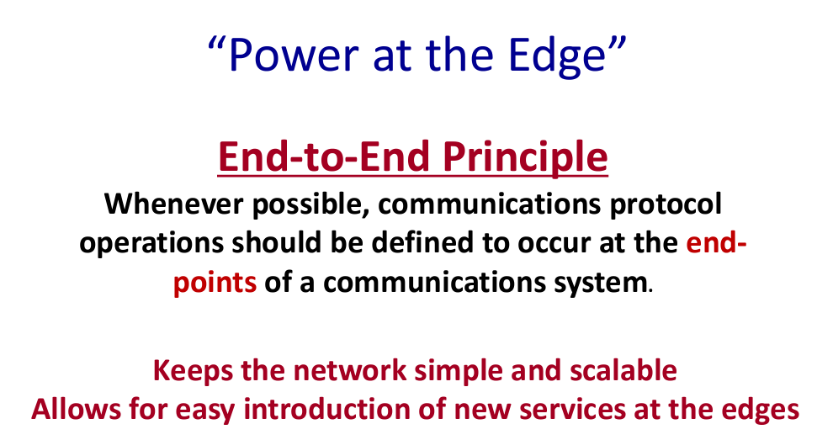

Slide 33
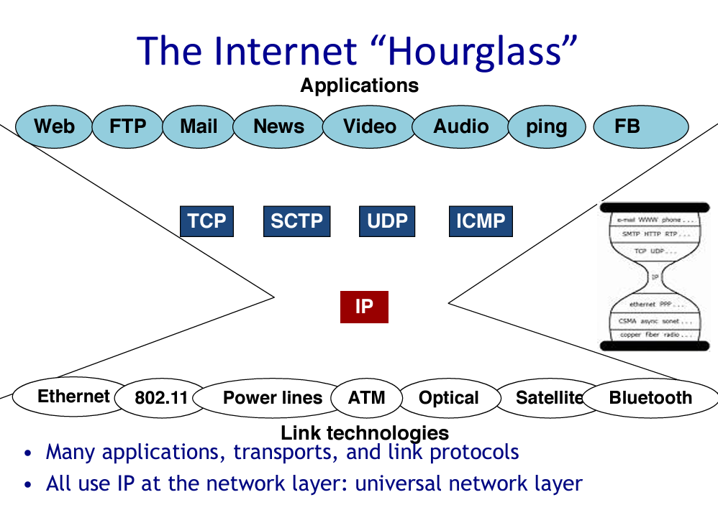

Slide 34
